Slide 1
SMP Stochastic Modelling and Processes
Lecture 5
Recap Chapter 5
Joint Distributions

Slide 2
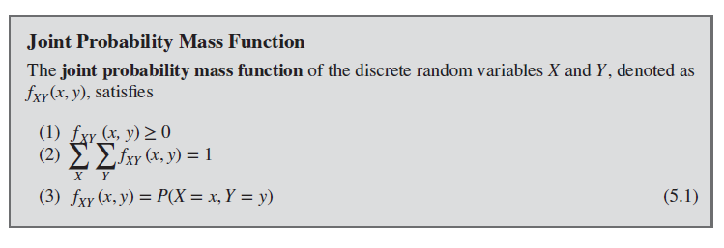
Joint Probability Mass Function

Slide 3
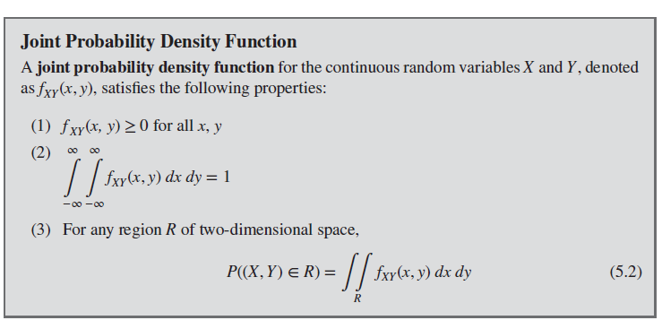
Joint Probability Density Function

Slide 4

Marginal Probability Distributions (discrete)
The individual probability distribution of a random variable is referred to as its marginal probability distribution.
Consider discrete random variables $X and Y$. To determine $P(X = x)$, we sum $P(X = x, Y = y)$over all points in the range of $(X, Y)$for which $X = x$. Subscripts on the probability mass functions distinguish between the random variables.

Slide 5
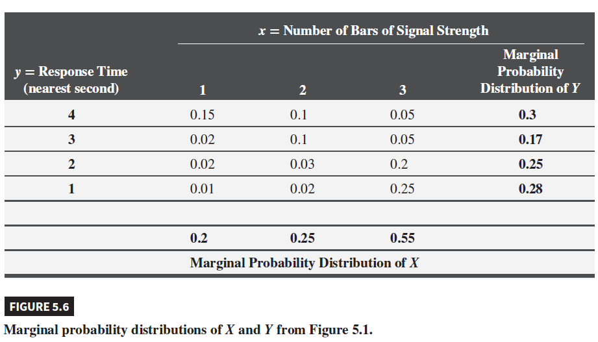
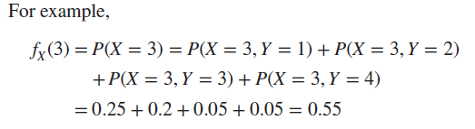
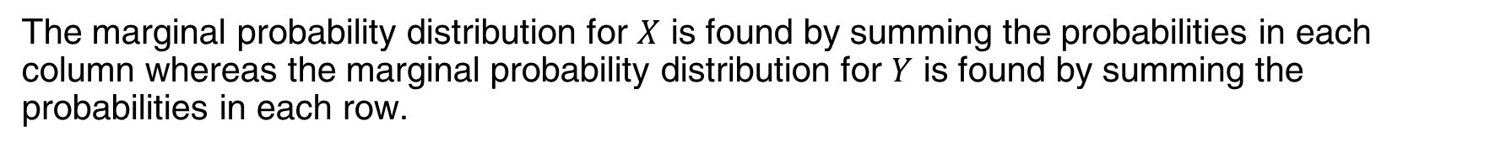
Example 5.3 | Marginal Distribution
The marginal probability distribution for is found by summing the probabilities in each column whereas the marginal probability distribution for is found by summing the probabilities in each row.

Slide 6
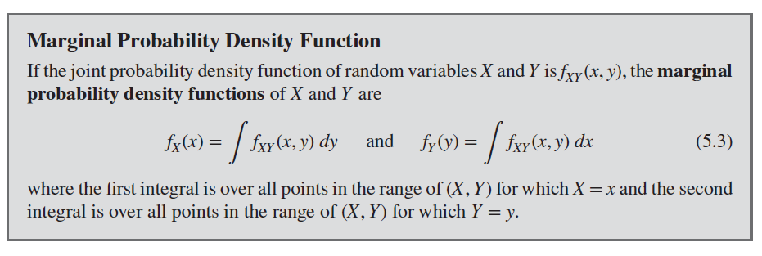
Marginal Probability Density Function

Slide 7
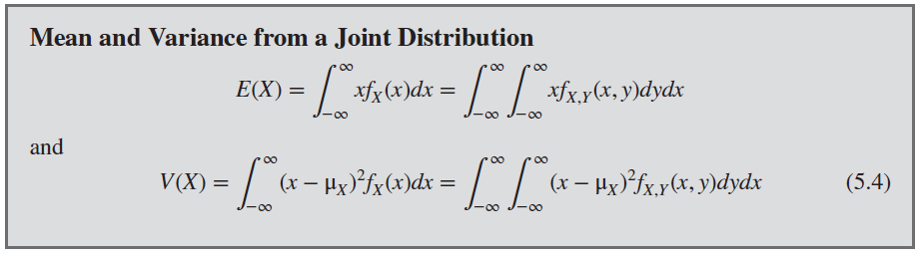
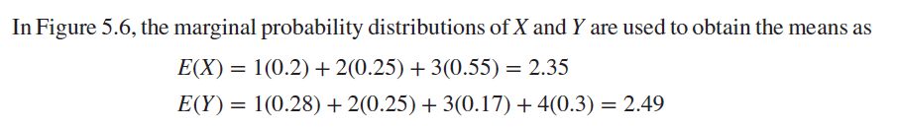
Mean and Variance from a Joint Distribution

Slide 8
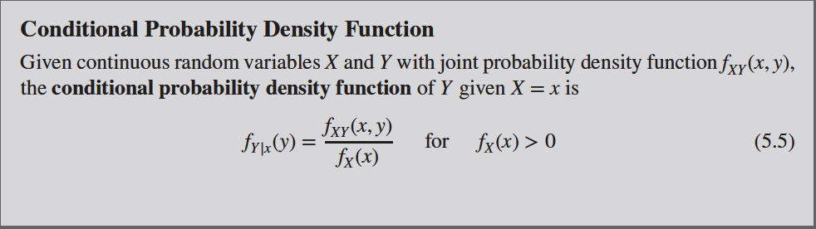
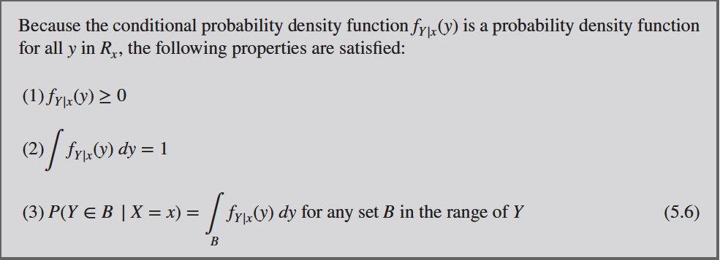
Conditional Probability Distributions

Slide 9
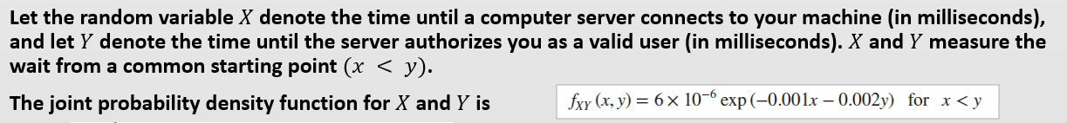
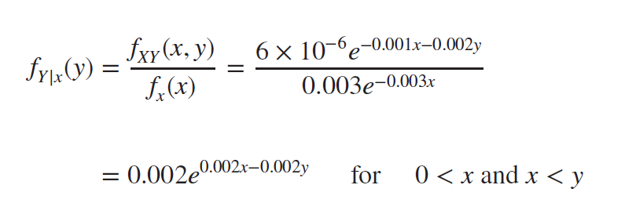
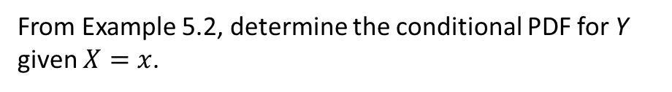
Example 5.6 | Conditional Probability
Now find the probability that Y exceeds 2000 given that X=1500:
From Example 5.2, determine the conditional PDF for Y given $X=x$.

Slide 10
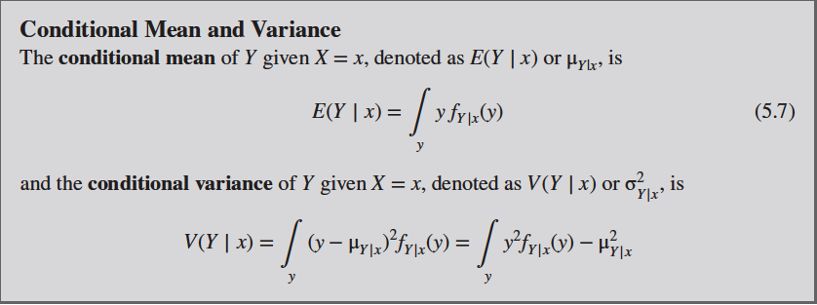
Conditional Mean and Variance

Slide 11

Example 5.7 | Conditional Mean and Variance
For the random variables that denote times in Example 5.2, determine the conditional mean for Y given that x = 1500. The conditional probability density function for Y was determined in Example 5.6. Because $f_{y|1500} (y)$is nonzero for y > 1500,

Slide 12
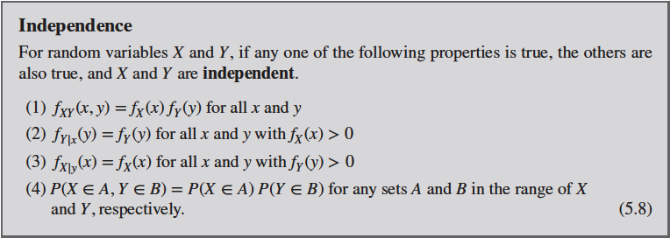
Independence

Slide 13
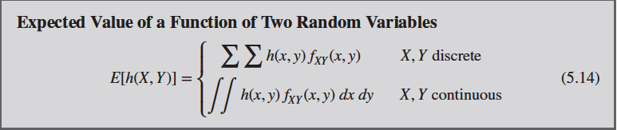
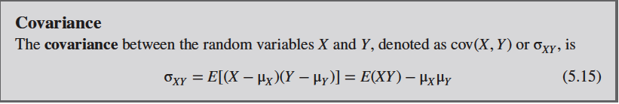
Covariance and Correlation
A common measure of the relationship between two random variables is the covariance
To define the covariance, we need to describe the expected value of a function of two random variables, h(X, Y)
The definition simply extends the one for a function of a single random variable
Notes:
import numpy as np
import matplotlib.pyplot as plt
n=100
x = np.random.randn(n)
y = x+np.random.randn(n)
plt.plot(x,'*')
plt.show()
plt.plot(y,'*')
plt.show()
plt.plot(x,y,'*')
covar = 1/(n-1)*np.sum((x-x.mean())*(y-y.mean()))
print(covar)
covar = np.cov(x,y, ddof=1)[0,1]
print(covar)

Slide 14


Covariance and Correlation
The covariance between and is defined as
Notes:
Now: Slides with Annotation
Next: Slides with Annotation

Slide 15
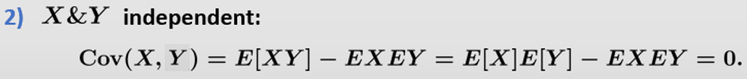

Covariance and Correlation
Lemma. The covariance has the following properties:
independent:
Notes:
Now: Slides with Annotation
Next: Slides with Annotation

Slide 16
Covariance and Correlation
Notes:
Now: Slides with Annotation
Next: Slides with Annotation

Slide 17
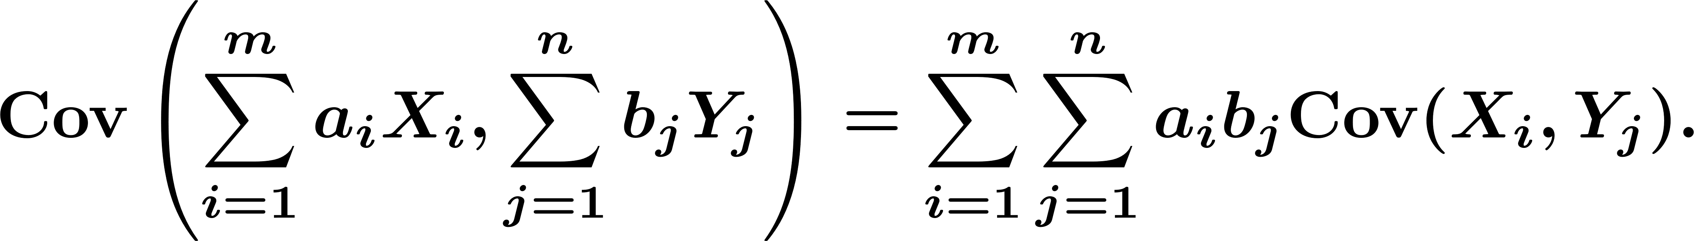
Covariance and Correlation
More generally
Notes:
Now: Slides with Annotation
Next: Slides with Annotation

Slide 18

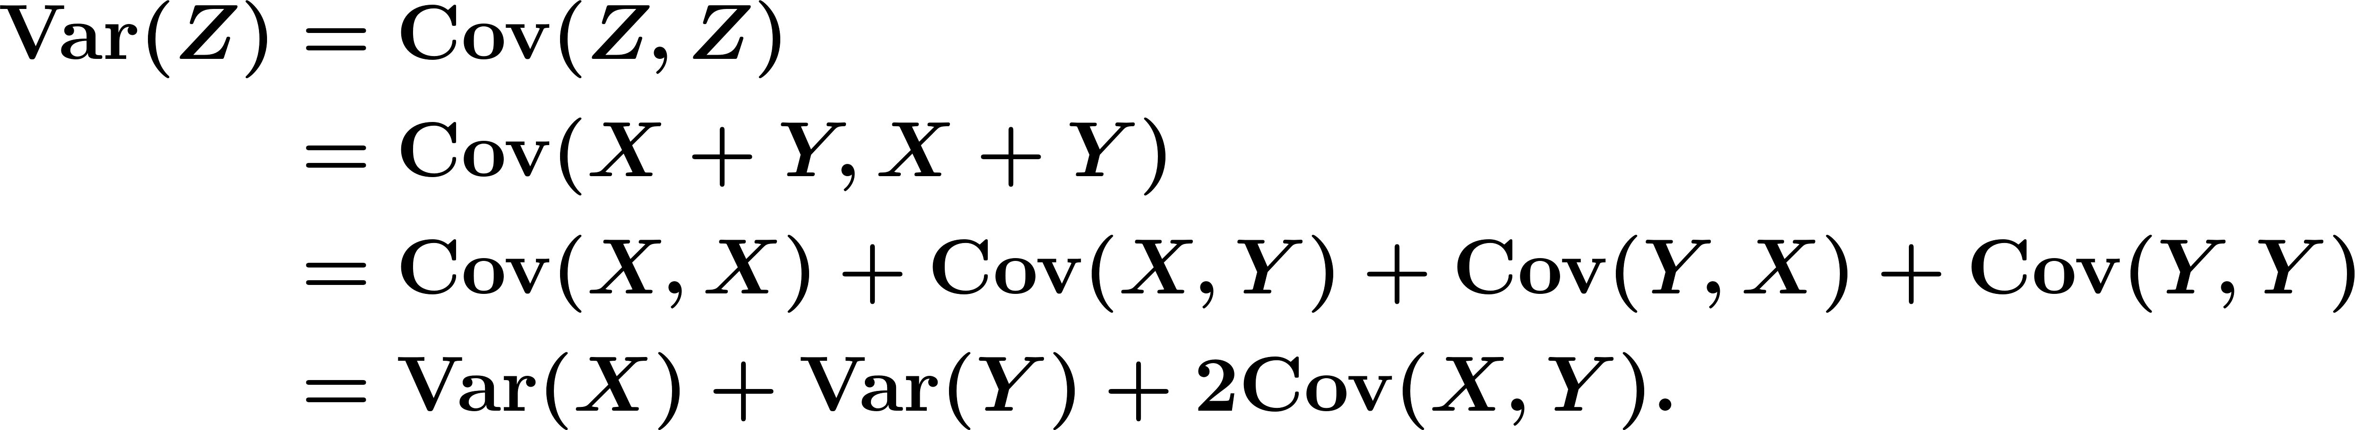
Covariance and Correlation
Variance of a sum:
If , then
Notes:
Now: Slides with Annotation
Next: Slides with Annotation

Slide 19

Covariance and Correlation
More generally, for , we conclude:
Notes:
Now: Slides with Annotation
Next: Slides with Annotation

Slide 20
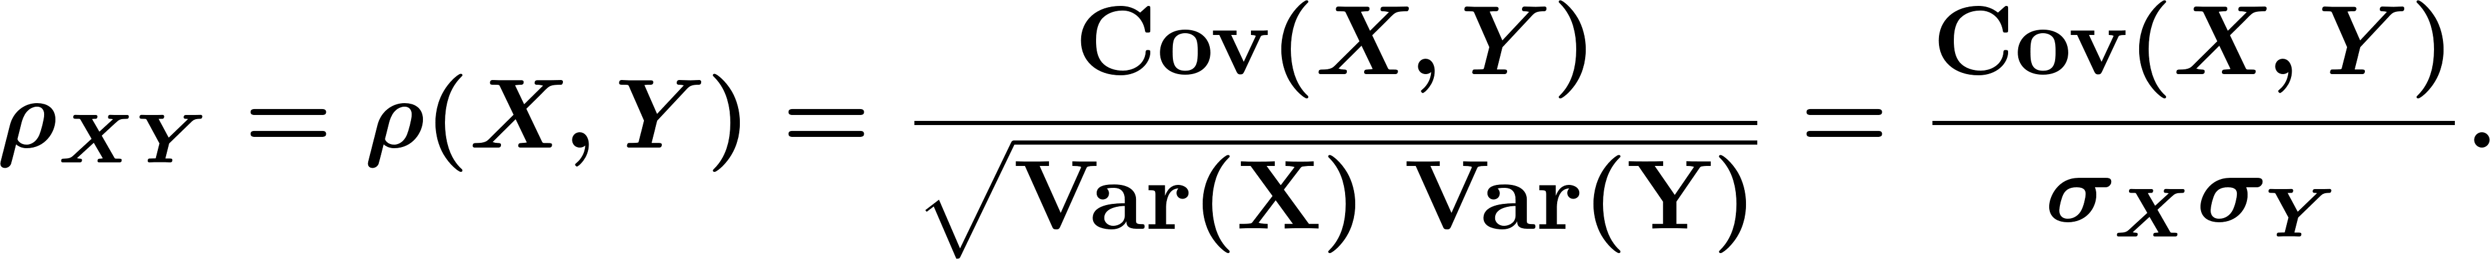
Covariance and Correlation
Correlation Coefficient:
Notes:
Now: Slides with Annotation
Next: Slides with Annotation

Slide 21
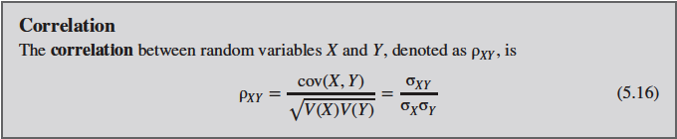

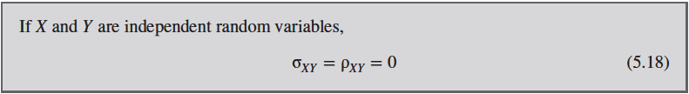
Covariance and Correlation
Notes:
corrcoeff = covar/(x.std(ddof=1)*y.std(ddof=1))
print(corrcoeff)
corrcoeff = np.corrcoef(x,y)[0,1]
print(corrcoeff)

Slide 22
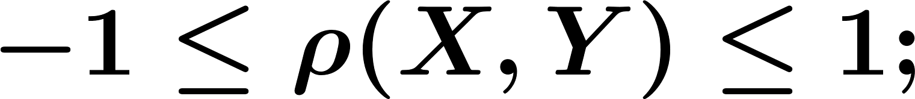
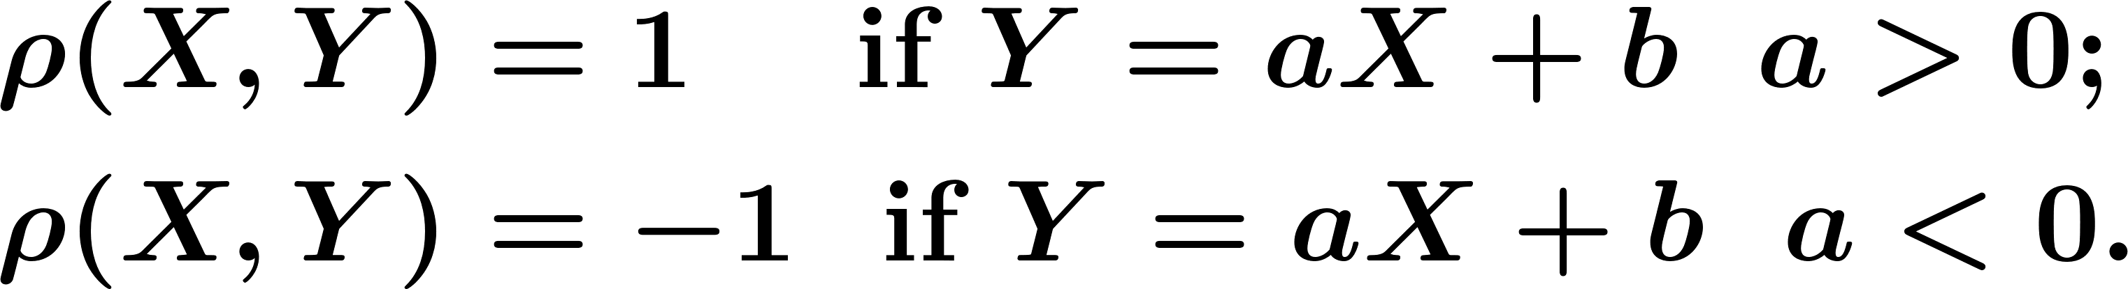
Covariance and Correlation
Properties of the correlation coefficient:
Notes:
Now: Slides with Annotation
Next: Slides with Annotation

Slide 23
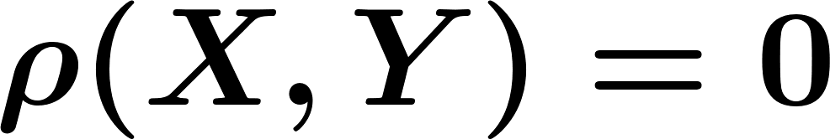
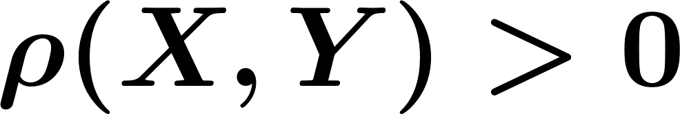
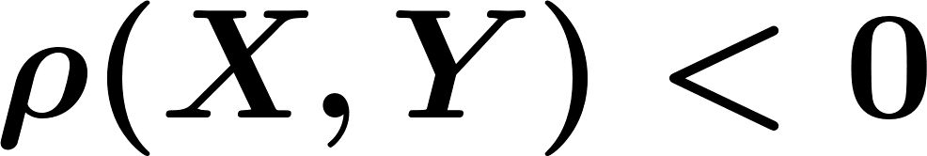
Covariance and Correlation
Definition. Consider two random variables and :
If , we say that and are uncorrelated.
If , we say that and are positively correlated.
If , we say that and are negatively correlated.
Notes:
Now: Slides with Annotation
Next: Slides with Annotation

Slide 24

i.i.d.: Independent and Identically distributed
Very important!
•
We define that for series of random variables that is taken from the same distribution (identically distributed), and are sampled independent of each other, that they are i.i.d.
i.i.d. = Independent and Identically distributed
•
i.i.d. is a very important characteristic in stochastic variable processing and statistics

